Slide 1
K-Mean Clustering Algorithm
G M RIFAT REZA
gmrr2242@gmail.com

Slide 2
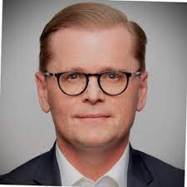
James MacQueen

Slide 3
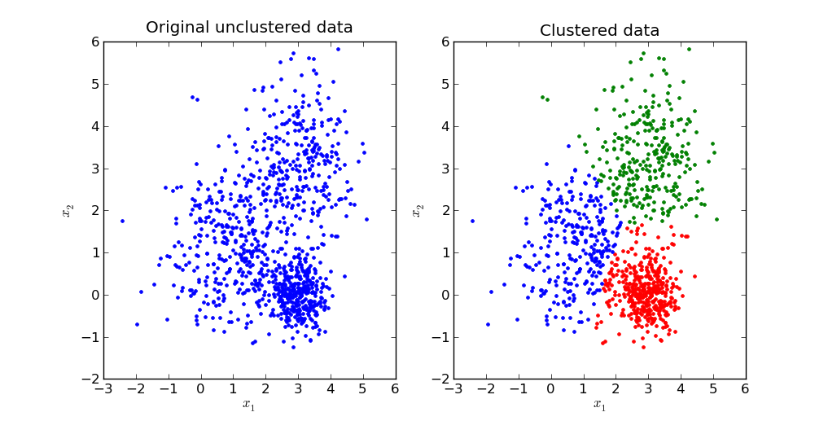
K-Mean Clustering Algorithm
k-means is one of the simplest unsupervised learning algorithms that solves the well-known clustering problem. The procedure follows a simple and easy way to classify a given data set through a certain number of clusters (assume k clusters)

Slide 4
How K-Mean Clustering Algorithm Works
The algorithm is an iterative process that refines its cluster assignments and centroid locations at each step.
Choose the number of clusters (k): The user must first specify the desired number of clusters, Determining the optimal value for is a crucial step that can significantly impact the results.
Initialize centroids: The algorithm begins by randomly placing centroids in the data space. For better results, advanced methods like K-means++ select initial centroids that are spread far apart.
Assign data points to clusters: The algorithm calculates the distance from each data point to every centroid, typically using the Euclidean distance. Each data point is then assigned to the cluster of the closest centroid.
Update centroids: For each cluster, the algorithm recalculates the centroid by taking the mean of all the data points assigned to that cluster.
Repeat until convergence: Steps 3 and 4 are repeated until the positions of the centroids no longer change or the maximum number of iterations is reached. This indicates that the clusters have stabilized.

Slide 5
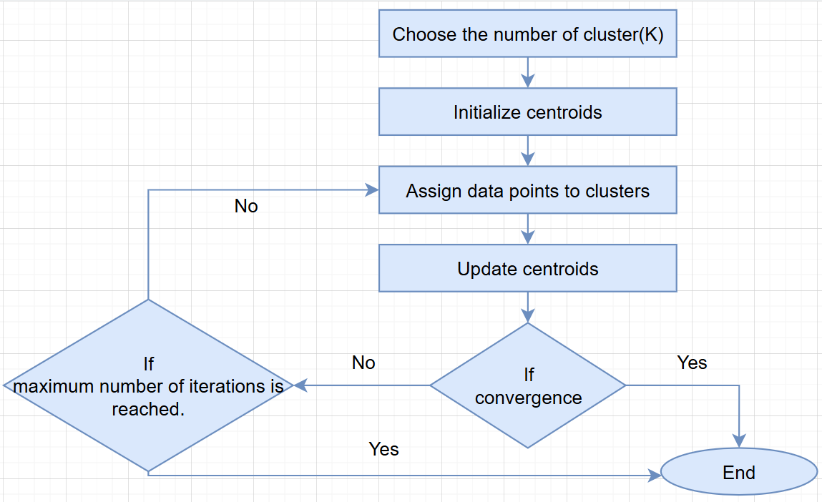
Flowchart - K-Mean Clustering Algorithm

Slide 6
K-Mean Clustering Algorithm
Problem
Divide the following data into two clusters using the k-mean clustering.
A(3,4) B(6,7) C(4,5), D(5,7) E(2,6)
Number of cluster will be defined by the user as his or her wish or will be given in the question. Like here given 2 in the problem.
Answer:
Initial Step: (Centroid selection)
For cluster-1: A(3, 4)
For cluster-2: C(4, 5)
Initial centroid will be taken random

Slide 7
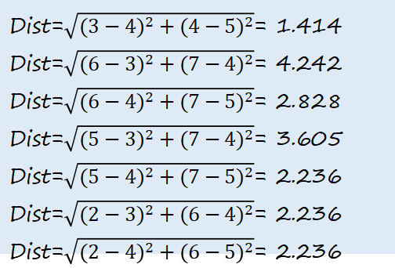
K-Mean Clustering Algorithm
Iteration -1
Side note
Data | Cluster-1 Centroid(3,4) | Cluster-2 Centroid(4,5) | Cluster
A(3,4) | 0 | 1.414 | Cluster-1
B(6,7) | 4.242 | 2.828 | Cluster-2
C(4,5) | 1.414 | 0 | Cluster-2
D(5,7) | 3.605 | 2.236 | Cluster-2
E(2,6) | 2.236 | 2.236 | Cluster-1
Dist=$\sqrt{{(3−4)}^{2}+{(4−5)}^{2}}$= 1.414
Dist=$\sqrt{{(6−3)}^{2}+{(7−4)}^{2}}$= 4.242
Dist=$\sqrt{{(6−4)}^{2}+{(7−5)}^{2}}$= 2.828
Dist=$\sqrt{{(5−3)}^{2}+{(7−4)}^{2}}$= 3.605
Dist=$\sqrt{{(5−4)}^{2}+{(7−5)}^{2}}$= 2.236
Dist=$\sqrt{{(2−3)}^{2}+{(6−4)}^{2}}$= 2.236
Dist=$\sqrt{{(2−4)}^{2}+{(6−5)}^{2}}$= 2.236

Slide 8
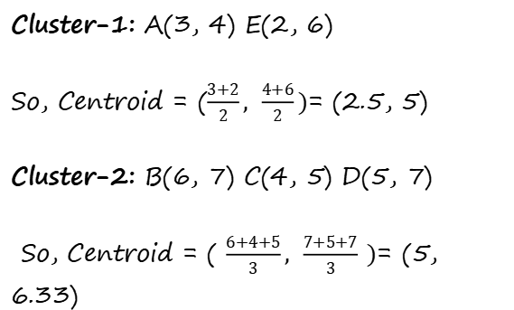
K-Mean Clustering Algorithm
Centroid Modification:
Mean
Cluster-1: A(3, 4) E(2, 6)
So, Centroid = ($\frac{3+2}{2}, \frac{4+6}{2})$= (2.5, 5)
Cluster-2: B(6, 7) C(4, 5) D(5, 7)
So, Centroid = ($\frac{6+4+5}{3}, \frac{7+5+7}{3} )$= (5, 6.33)
Mean

Slide 9
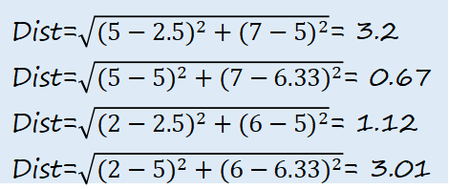
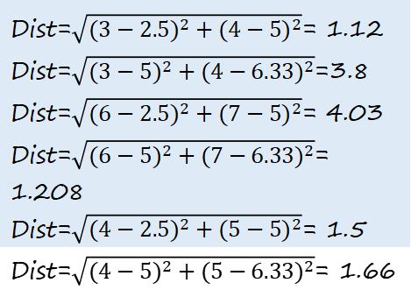
K-Mean Clustering Algorithm
Side note
Dist=$\sqrt{{(3−2.5)}^{2}+{(4−5)}^{2}}$= 1.12
Dist=$\sqrt{{(3−5)}^{2}+{(4−6.33)}^{2}}$=3.8
Dist=$\sqrt{{(6−2.5)}^{2}+{(7−5)}^{2}}$= 4.03
Dist=$\sqrt{{(6−5)}^{2}+{(7−6.33)}^{2}}$= 1.208
Dist=$\sqrt{{(4−2.5)}^{2}+{(5−5)}^{2}}$= 1.5
Dist=$\sqrt{{(4−5)}^{2}+{(5−6.33)}^{2}}$= 1.66
Iteration -2
Data | Cluster-1 Centroid(2.5,5) | Cluster-2 Centroid(5,6.33) | Cluster
A(3,4) | 1.12 | 3.8 | Cluster-1
B(6,7) | 4.03 | 1.208 | Cluster-2
C(4,5) | 1.5 | 1.66 | Cluster-1
D(5,7) | 3.2 | 0.67 | Cluster-2
E(2,6) | 1.12 | 3.01 | Cluster-1
Dist=$\sqrt{{(5−2.5)}^{2}+{(7−5)}^{2}}$= 3.2
Dist=$\sqrt{{(5−5)}^{2}+{(7−6.33)}^{2}}$= 0.67
Dist=$\sqrt{{(2−2.5)}^{2}+{(6−5)}^{2}}$= 1.12
Dist=$\sqrt{{(2−5)}^{2}+{(6−6.33)}^{2}}$= 3.01

Slide 10
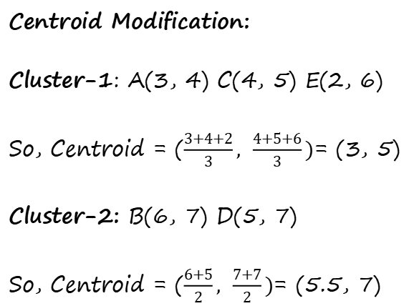
K-Mean Clustering Algorithm
Centroid Modification:
Cluster-1: A(3, 4) C(4, 5) E(2, 6)
So, Centroid = ($\frac{3+4+2}{3}, \frac{4+5+6}{3})$= (3, 5)
Cluster-2: B(6, 7) D(5, 7)
So, Centroid = ($\frac{6+5}{2}, \frac{7+7}{2})$= (5.5, 7)

Slide 11
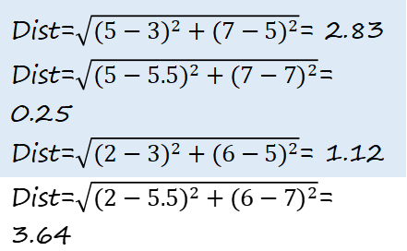
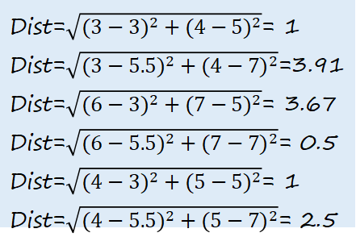
K-Mean Clustering Algorithm
Side note
Dist=$\sqrt{{(3−3)}^{2}+{(4−5)}^{2}}$= 1
Dist=$\sqrt{{(3−5.5)}^{2}+{(4−7)}^{2}}$=3.91
Dist=$\sqrt{{(6−3)}^{2}+{(7−5)}^{2}}$= 3.67
Dist=$\sqrt{{(6−5.5)}^{2}+{(7−7)}^{2}}$= 0.5
Dist=$\sqrt{{(4−3)}^{2}+{(5−5)}^{2}}$= 1
Dist=$\sqrt{{(4−5.5)}^{2}+{(5−7)}^{2}}$= 2.5
Iteration -3
Data | Cluster-1 Centroid(3,5) | Cluster-2 Centroid(5.5, 7) | Cluster
A(3,4) | 1 | 3.91 | Cluster-1
B(6,7) | 3.67 | 0.5 | Cluster-2
C(4,5) | 1 | 2.5 | Cluster-1
D(5,7) | 2.83 | 0.25 | Cluster-2
E(2,6) | 1.12 | 3.64 | Cluster-1
Dist=$\sqrt{{(5−3)}^{2}+{(7−5)}^{2}}$= 2.83
Dist=$\sqrt{{(5−5.5)}^{2}+{(7−7)}^{2}}$= 0.25
Dist=$\sqrt{{(2−3)}^{2}+{(6−5)}^{2}}$= 1.12
Dist=$\sqrt{{(2−5.5)}^{2}+{(6−7)}^{2}}$= 3.64
When centroid will not change then that is the final cluster.

Slide 12
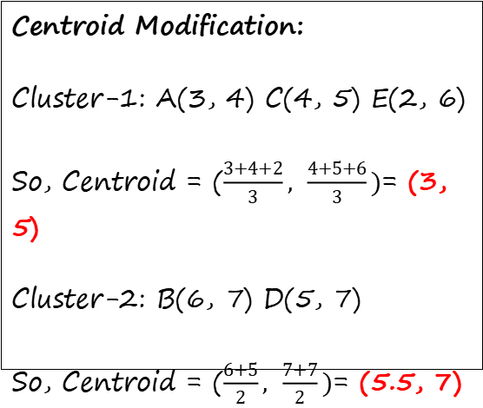
K-Mean Clustering Algorithm
Centroid Modification:
Cluster-1: A(3, 4) C(4, 5) E(2, 6)
So, Centroid = ($\frac{3+4+2}{3}, \frac{4+5+6}{3})$= (3, 5)
Cluster-2: B(6, 7) D(5, 7)
So, Centroid = ($\frac{6+5}{2}, \frac{7+7}{2})$= (5.5, 7)
Final Output
Data | Cluster | Centroid
A(3,4) C(4,5) E(2,6) | Cluster-1 | (3,5)
B(6,7) D(5,7) | Cluster-2 | (5.5, 7)

Slide 13
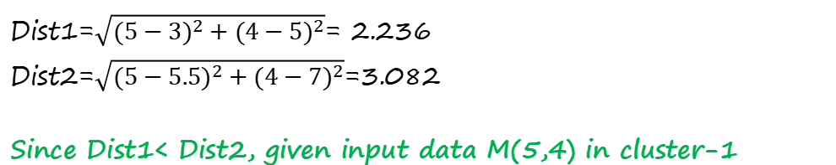
K-Mean Clustering Algorithm
Problem
Decide which cluster contain the input data M(5,4)
Answer:
Dist1=$\sqrt{{(5−3)}^{2}+{(4−5)}^{2}}$= 2.236
Dist2=$\sqrt{{(5−5.5)}^{2}+{(4−7)}^{2}}$=3.082
Since Dist1< Dist2, given input data M(5,4) in cluster-1

Slide 14
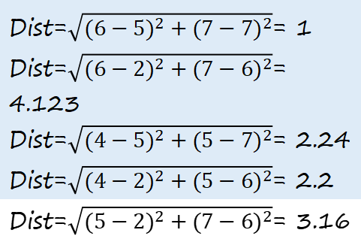
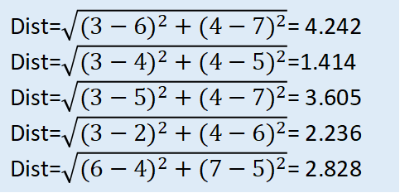
Modified K-Mean Clustering Algorithm
Side Note
Dist=$\sqrt{{(3−6)}^{2}+{(4−7)}^{2}}$= 4.242
Dist=$\sqrt{{(3−4)}^{2}+{(4−5)}^{2}}$=1.414
Dist=$\sqrt{{(3−5)}^{2}+{(4−7)}^{2}}$= 3.605
Dist=$\sqrt{{(3−2)}^{2}+{(4−6)}^{2}}$= 2.236
Dist=$\sqrt{{(6−4)}^{2}+{(7−5)}^{2}}$= 2.828
Centroid Selection
Data | A(3,4) | B(6,7) | C(4,5) | D(5,7) | E(2,6)
A(3,4) | 0 | 4.242 | 1.414 | 3.605 | 2.236
B(6,7) |  | 0 | 2.828 | 1 | 4.123
C(4,5) |  |  | 0 | 2.24 | 2.2
D(5,7) |  |  |  | 0 | 3.16
E(2,6) |  |  |  |  | 0
Dist=$\sqrt{{(6−5)}^{2}+{(7−7)}^{2}}$= 1
Dist=$\sqrt{{(6−2)}^{2}+{(7−6)}^{2}}$= 4.123
Dist=$\sqrt{{(4−5)}^{2}+{(5−7)}^{2}}$= 2.24
Dist=$\sqrt{{(4−2)}^{2}+{(5−6)}^{2}}$= 2.2
Dist=$\sqrt{{(5−2)}^{2}+{(7−6)}^{2}}$= 3.16
So, Initial centroid
For Cluster 1: (3, 4)
For Cluster 2: (6, 7)

Slide 15
Key concepts of K-Mean Clustering Algorithm
Unsupervised learning: The algorithm works with unlabeled data, meaning it discovers inherent patterns in the dataset without prior knowledge of the categories.
Centroid-based: It groups data based on the mean location of its members. The goal is to minimize the total intra-cluster variance, also known as the "within-cluster sum of squares" (WCSS).
Convergence: The algorithm is guaranteed to converge, though not necessarily to the global optimum. Because it can get stuck in a local minimum, it is common to run the algorithm multiple times with different starting conditions.

Slide 16
Advantages of K-Mean Clustering Algorithm
Simple and fast: The algorithm is easy to understand and implement and is very efficient, making it scalable for large datasets.
Versatile: K-means is widely used across various fields, including customer segmentation, image compression, and anomaly detection.
Interpretable results: The resulting clusters are generally easy to interpret and visualize.

Slide 17
Limitations of K-Mean Clustering Algorithm
Sensitive to initial centroids: The final clustering can depend heavily on the random initial placement of the centroids.
Manual choice of k: The user must determine the number of clusters, k, beforehand. The optimal number is not always obvious.
Assumes spherical clusters: The algorithm works best with clusters that are roughly spherical and of similar size. It performs poorly with clusters of varying shapes, sizes, or densities.
Sensitive to outliers: Outliers can significantly skew the position of the centroids, affecting the accuracy of the final clustering.

Slide 18
Applications of K-Mean Clustering Algorithm
Customer segmentation: Grouping customers based on purchasing behavior to create targeted marketing campaigns.
Image compression: Reducing the number of colors in an image by grouping similar pixel colors into clusters and replacing them with the cluster's centroid.
Document clustering: Grouping similar documents based on content, often used in recommendation systems or information retrieval.
Anomaly detection: Identifying outliers that do not fit into any cluster, which can be useful for flagging fraudulent transactions.

